Slide 1

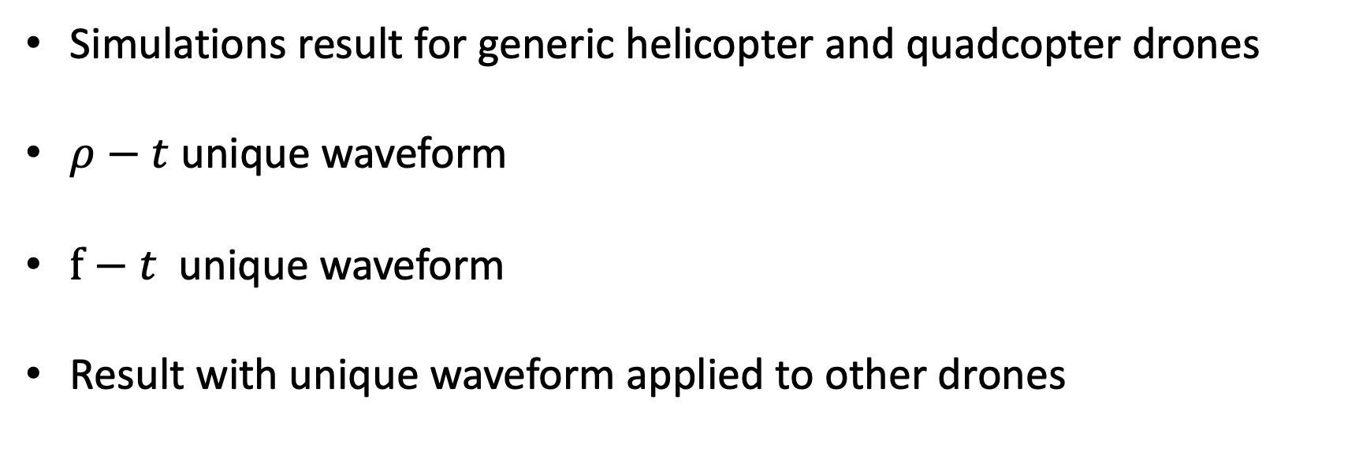
Contents
Simulations result for generic helicopter and quadcopter drones
$ρ−t$ unique waveform
$f−t$ unique waveform
Result with unique waveform applied to other drones

Slide 2
Generic drone model parameters
Helicopter drones:
Drone RCS are supposed to be: $σ=0.03 m^{2}$ $σ_{blade }=0.75σ$ ${ σ}_{body }=0.25σ$
$$L_{1}$$ | $$L_{2}$$ | $$Ω$$ | $${ N}_{b}$$ | $${ N}_{r}$$ | $${ n}_{p}$$
$$0 mm$$ | $$600 mm$$ | $$25 rev/s$$ | $$2$$ | $$1$$ | $$46$$
Quadcopter drones:
Drone RCS are supposed to be: $σ=0.01 m^{2}$ $σ_{blade }=0.75σ$ ${ σ}_{body }=0.25σ$
$$L_{1}$$ | $$L_{2}$$ | $$Ω$$ | $${ N}_{b}$$ | $${ N}_{r}$$ | $${ n}_{p}$$ | $${δ }_{max}$$
$$0 mm$$ | $$100 mm$$ | $$100 rev/s$$ | $$2$$ | $$4$$ | $$6$$ | 101mm
The blade flash start to appear when there is 1 point each 1.6 cm, are much evident for 1 point each 1.3 cm

Slide 3

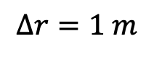
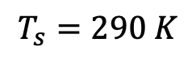
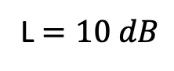
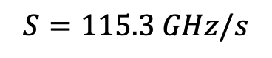
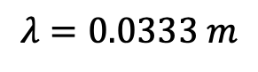
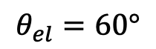

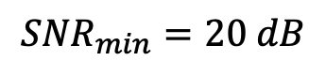
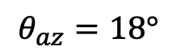
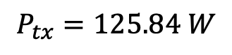
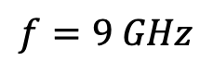

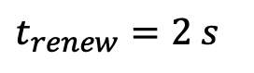

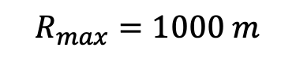
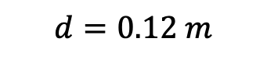
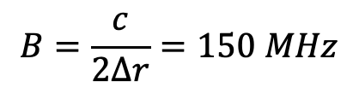
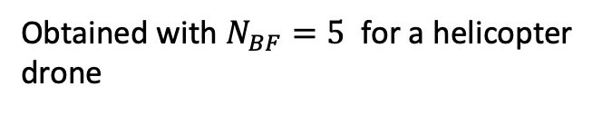
Result $ρ−t \text{helic}\text{. }\text{drones}$
Based on studied result on $ρ−t$ plane, in order to find a unique waveform for both quad. and helic. drones:
Usual radar starting parameters:
With chosen:
Obtained with $N_{BF}=5$ for a helicopter drone
$$f=9 GHz$$
$$t_{dwell}=0.1 s$$
(The max one)
$$λ=0.0333 m$$
$$T_{chirp}=1.3 ms$$
(The max one req. for quad.)
$$∆r=1 m$$
With this chirp we accept to not measure the number of rotors otherwise the required power is too big
$$B=\frac{c}{2∆r}=150 MHz$$
$t_{renew}=2 s$
Follows:
$$P_{tx}=125.84 W$$
In order to decrease required power:
$${SNR}_{min}=20 dB$$
$$S=115.3 GHz/s$$
$$θ_{el}=60°$$
${ f}_{ADC}$ $=1.55 MHz$
1. Increase renewal time,
$$T_{s}=290 K$$
2. Decrease dwell time,
$$d=0.12 m$$
$$R_{max}=1000 m$$
3. Decrease max Range,
$$θ_{az}=18°$$
4. Assume lower Noise Figure,
L $=10 dB$
5. Decrease the SNR min required.

Slide 4

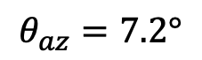
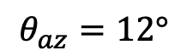
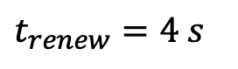
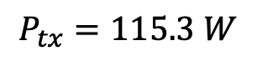


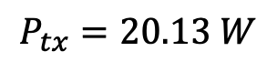



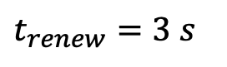



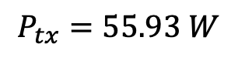

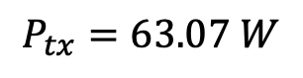
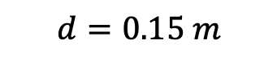
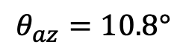

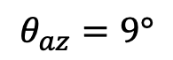
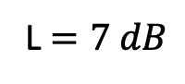


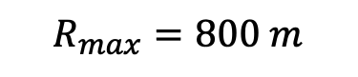
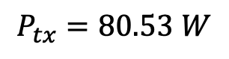

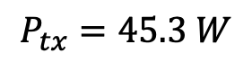

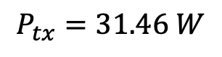
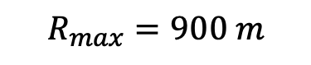
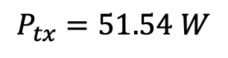
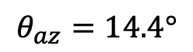
Result $ρ−t \text{helic}\text{. }\text{drones}$
By decreasing $N_{BF}$, so the dwell time:
Follows:
$$P_{tx}=80.53 W$$
$$θ_{az}=14.4°$$
$$d=0.15 m$$
$$N_{BF}=4$$
$$t_{dwell}=0.08 s$$
$$N_{BF}=3$$
$$t_{dwell}=0.06 s$$
$$P_{tx}=45.3 W$$
$$θ_{az}=10.8°$$
$$d=0.2 m$$
$$N_{BF}=2$$
$$t_{dwell}=0.04 s$$
$$P_{tx}=20.13 W$$
$$θ_{az}=7.2°$$
$$d=0.3 m$$
By increasing the renewal time:
$$t_{dwell}=0.1 s$$
$$P_{tx}=55.93 W$$
$$θ_{az}=12°$$
$$d=0.18 m$$
$t_{renew}=3 s$
$t_{renew}=4 s$
$$T_{chirp}=1.3 ms$$
$$P_{tx}=31.46 W$$
$$θ_{az}=9°$$
$$d=0.24 m$$
By decreasing the max range:
By decreasing only the Noise Figure:
$$t_{dwell}=0.1 s$$
$$P_{tx}=115.3 W$$
$$R_{max}=900 m$$
L $=7 dB$
$$P_{tx}=63.07 W$$
$$R_{max}=800 m$$
$$T_{chirp}=1.3 ms$$
$$P_{tx}=51.54 W$$

Slide 5
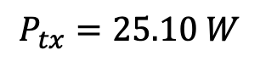


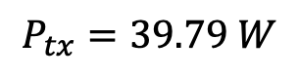
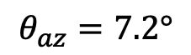
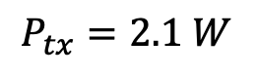

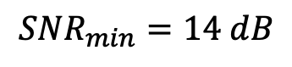
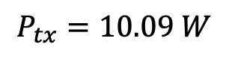
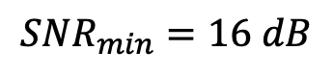

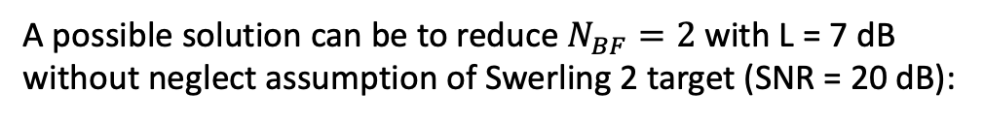

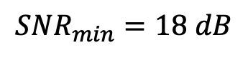
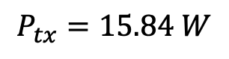

Result $ρ−t \text{helic}\text{. }\text{drones}$
By decreasing the minimum SNR and assuming L = 7 dB:
$${SNR}_{min}=18 dB$$
$$P_{tx}=39.79 W$$
$${SNR}_{min}=16 dB$$
$$P_{tx}=25.10 W$$
$${SNR}_{min}=14 dB$$
$$P_{tx}=15.84 W$$
A possible solution can be to reduce $N_{BF}=2$ with L = 7 dB without neglect assumption of Swerling 2 target (SNR = 20 dB):
$$t_{dwell}=0.04 s$$
$$T_{chirp}=1.3 ms$$
$$P_{tx}=10.09 W$$
$$θ_{az}=7.2°$$
$$d=0.3 m$$
By replacing the assumption of Swerling 2 target with Swerling 1 -> SNR = 13.2 dB:
$$t_{dwell}=0.04 s$$
$$T_{chirp}=1.3 ms$$
$$P_{tx}=2.1 W$$
$$θ_{az}=7.2°$$
$$d=0.3 m$$

Slide 6
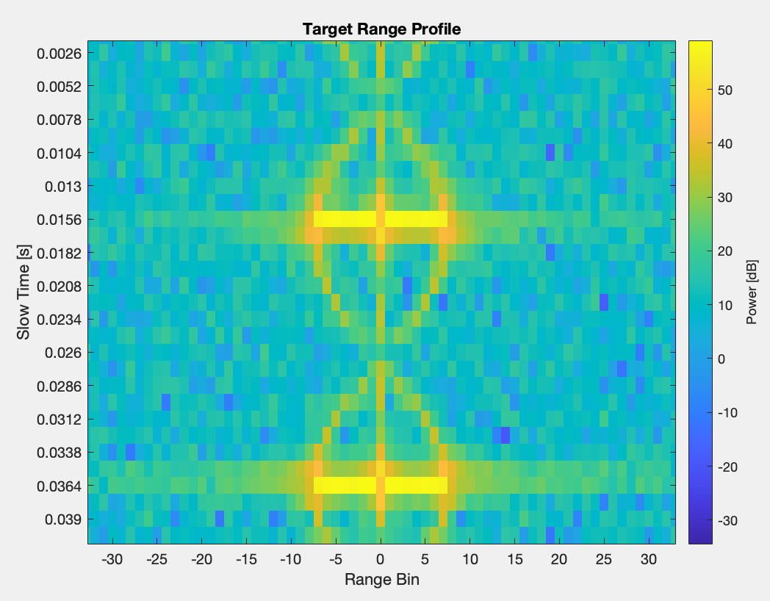
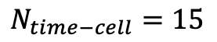

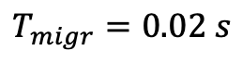
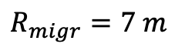
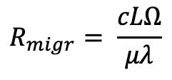












Result $ρ−t \text{helic}\text{. }\text{drones}$
$$t_{dwell}=0.04 s$$
$${SNR}_{min}=13.2 dB$$
$$T_{chirp}=1.3 ms$$
Features extracted:
$$N_{range−cell}=7$$
$$R_{migr}=7 m$$
$$R_{migr}= \frac{cLΩ}{μλ}$$
$$v_{tip}=LΩ$$
$$v_{tip}=89.68 m/s$$
$$N_{time−cell}=15$$
$$T_{migr}=0.0195 s$$
$$Ω= \frac{2π}{N_{b}T_{migr}}$$
$$N_{b}=2$$
$Ω$= 161.107 rad/s
The real values are:
$L$=$\frac{v_{tip}}{Ω}$ = 0.597 m
$L$=$0.6$m
$$T_{migr}=0.02 s$$

Slide 7






Result $ρ−t \text{quad}\text{. }\text{drones}$
Based on studied result on $ρ−t$ plane, in order to find a unique waveform for both quad. and helic. drones:
Usual radar starting parameters:
With chosen:
Obtained with $N_{BF}=5$ for a helicopter drone
$$f=9 GHz$$
$$t_{dwell}=0.1 s$$
(The max one)
$$λ=0.0333 m$$
$$T_{chirp}=1.3 ms$$
(The max one req. for quad.)
$$∆r=1 m$$
$$B=\frac{c}{2∆r}=150 MHz$$
Follows:
$t_{renew}=2 s$
$$P_{tx}=377.52W$$
In order to decrease required power:
$${SNR}_{min}=20 dB$$
$$S=115.3 GHz/s$$
${ f}_{ADC}$ $=1.55 MHz$
1. Increase renewal time,
$$θ_{el}=60°$$
2. Decrease dwell time,
$$d=0.12 m$$
$$T_{s}=290 K$$
3. Decrease max Range,
$$θ_{az}=18°$$
4. Assume lower Noise Figure.
$$R_{max}=1000 m$$
5. Decrease the SNR min required.
L $=10 dB$

Slide 8








Result $ρ−t \text{quad}\text{. }\text{drones}$
By decreasing $N_{BF}$, so the dwell time:
Follows:
$$P_{tx}=241.61W$$
$$θ_{az}=14.4°$$
$$d=0.15 m$$
$$N_{BF}=4$$
$$t_{dwell}=0.08 s$$
$$N_{BF}=3$$
$$t_{dwell}=0.06 s$$
$$P_{tx}=135.91W$$
$$θ_{az}=10.8°$$
$$d=0.2 m$$
$$N_{BF}=2$$
$$t_{dwell}=0.04 s$$
$$P_{tx}=60.4 W$$
$$θ_{az}=7.2°$$
$$d=0.3 m$$
By increasing the renewal time:
$$t_{dwell}=0.1 s$$
$$P_{tx}=167.79 W$$
$$θ_{az}=12°$$
$$d=0.18 m$$
$t_{renew}=3 s$
$t_{renew}=4 s$
$$T_{chirp}=1.3 ms$$
$$P_{tx}=94.38 W$$
$$θ_{az}=9°$$
$$d=0.24 m$$
By decreasing the max range:
By decreasing only the Noise Figure:
$$t_{dwell}=0.1 s$$
$$P_{tx}=247.69 W$$
$$R_{max}=900 m$$
L $=7 dB$
$$P_{tx}=189.21 W$$
$$R_{max}=800 m$$
$$T_{chirp}=1.3 ms$$
$$P_{tx}=154.63 W$$

Slide 9

















Result $ρ−t \text{quad}\text{. }\text{drones}$
By decreasing the minimum SNR and we assume L = 7 dB:
$${SNR}_{min}=18 dB$$
$$P_{tx}=119.38 W$$
$${SNR}_{min}=16 dB$$
$$P_{tx}=75.32 W$$
$${SNR}_{min}=14 dB$$
$$P_{tx}=47.52 W$$
A possible solution can be to reduce $N_{BF}=2$ with L = 7 dB without neglect assumption of Swerling 2 target (SNR = 20 dB):
$$t_{dwell}=0.04 s$$
$$T_{chirp}=1.3 ms$$
$$P_{tx}=30.27 W$$
$$θ_{az}=7.2°$$
$$d=0.3 m$$
By replacing the assumption of Swerling 2 target with Swerling 0 -> SNR = 13.2 dB:
$$t_{dwell}=0.04 s$$
$$T_{chirp}=1.3 ms$$
$$P_{tx}=6.32 W$$
$$θ_{az}=7.2°$$
$$d=0.3 m$$

Slide 10

















Result $ρ−t \text{quad}\text{. }\text{drones}$
$$t_{dwell}=0.04 s$$
$${SNR}_{min}=13.2 dB$$
$$T_{chirp}=1.3 ms$$
Features extracted:
$$N_{range−cell}=5$$
$$R_{migr}=5 m$$
$$R_{migr}= \frac{cLΩ}{μλ}$$
$$v_{tip}=LΩ$$
$$v_{tip}=64.058 m/s$$
$$N_{time−cell}=4$$
$$T_{migr}=0.0052 s$$
$$Ω= \frac{2π}{N_{b}T_{migr}}$$
$$N_{b}=2$$
$Ω$= 604.1524 rad/s
The real values are:
$L$=$\frac{v_{tip}}{Ω}$ = 0.106 m
$L$=$0.1$m
$$T_{migr}=0.0050 s$$

Slide 11









Result f$−t \text{helic}\text{. }\text{drones}$
Based on studied result on f$−t$ plane, in order to find a unique waveform for both quad. and helic. drones:
Usual radar starting parameters:
With chosen:
Obtained with $N_{BF}=5$ for a helicopter drone
$$f=9 GHz$$
$$t_{dwell}=0.1 s$$
(The max one)
$$λ=0.0333 m$$
$$T_{chirp}=66.7μs$$
(The min one possible to satisfy unambiguous range)
$$∆r=1 m$$
$$N_{fft}=12$$
$$B=\frac{c}{2∆r}=150 MHz$$
$$Δt=0.2 s$$
$$Δf=1249 Hz$$
$t_{renew}=2 s$
Follows:
$${SNR}_{min}=20 dB$$
$$P_{tx}=204.39 W$$
In order to decrease required power:
$$θ_{el}=60°$$
$$S=2247 GHz/s$$
1. Increase renewal time,
$$T_{s}=290 K$$
${ f}_{ADC}$ $=29.99 MHz$
2. Decrease dwell time,
3. Decrease max Range,
$$R_{max}=1000 m$$
$$d=0.12 m$$
4. Assume lower Noise Figure.
L $=10 dB$
$$θ_{az}=18°$$
5. Decrease the SNR min required.

Slide 12









Result f$−t \text{helic}\text{. }\text{drones}$
By decreasing $N_{BF}$, so the dwell time:
Follows:
$$P_{tx}=130.81 W$$
$$θ_{az}=14.4°$$
$$d=0.15 m$$
$$N_{BF}=4$$
$$t_{dwell}=0.08 s$$
$$N_{BF}=3$$
$$t_{dwell}=0.06 s$$
$$P_{tx}=73.58 W$$
$$θ_{az}=10.8°$$
$$d=0.2 m$$
$$N_{BF}=2$$
$$t_{dwell}=0.04 s$$
$$P_{tx}=32.70 W$$
$$θ_{az}=7.2°$$
$$d=0.3 m$$
By increasing the renewal time:
$$P_{tx}=90.84W$$
$$θ_{az}=12°$$
$$d=0.18 m$$
$t_{renew}=3 s$
$t_{renew}=4 s$
$$P_{tx}=51.09 W$$
$$θ_{az}=9°$$
$$d=0.24 m$$
By decreasing the max range:
By decreasing only the Noise Figure:
$$P_{tx}=134.1 W$$
$$R_{max}=900 m$$
L $=7 dB$
$$P_{tx}=102.43 W$$
$$R_{max}=800 m$$
$$P_{tx}=83.7 W$$

Slide 13

















Result f$−t \text{helic}\text{. }\text{drones}$
By decreasing the minimum SNR and we assume L = 7 dB:
$${SNR}_{min}=18 dB$$
$$P_{tx}=64.63 W$$
$${SNR}_{min}=16 dB$$
$$P_{tx}=40.78 W$$
$${SNR}_{min}=14 dB$$
$$P_{tx}=25.73 W$$
A possible solution can be to reduce $N_{BF}=2$ with L = 7 dB without neglect assumption of Swerling 2 target (SNR = 20 dB):
$$t_{dwell}=0.04 s$$
$$T_{chirp}=66.7μs$$
$$P_{tx}=16.39 W$$
$$θ_{az}=7.2°$$
$$d=0.3 m$$
$$N_{fft}=12$$
By replacing the assumption of Swerling 2 target with Swerling 0 -> SNR = 13.2 dB:
$$t_{dwell}=0.04 s$$
$$T_{chirp}=66.7μs$$
$$P_{tx}=3.42 W$$
$$θ_{az}=7.2°$$
$$d=0.3 m$$
$$N_{fft}=12$$

Slide 14




















Result f$−t \text{helic}\text{. }\text{drones}$
$$t_{dwell}=0.04 s$$
$$T_{chirp}=66.7μs$$
$$N_{fft}=12$$
$${SNR}_{min}=13.2 dB$$
$$Δf=1249 Hz$$
$$Δt=0.0002 s$$
Features extracted:
$$n_{f}=4$$
$$n_{t}=100$$
$$f_{max}=4997 Hz$$
$$T_{BF}=0.02 s$$
$$v_{tip}= \frac{{λf}_{max}}{2}$$
$$v_{tip}=104.043 m/s$$
$$N_{b}=2$$
$$Ω= \frac{2π}{N_{b}T_{BF}}$$
$$v_{tip}=LΩ$$
$Ω$= 157.079 rad/s
The real values are:
$L$=$\frac{v_{tip}}{Ω}$ = 0.662 m
$L$=$0.6$m
$$T_{BF}=0.02 s$$

Slide 15


Result f$−t \text{quad}\text{. }\text{drones}$
Based on studied result on f$−t$ plane, in order to find a unique waveform for both quad. and helic. drones:
Usual radar starting parameters:
With chosen:
Obtained with $N_{BF}=5$ for a helicopter drone
$$f=9 GHz$$
$$t_{dwell}=0.1 s$$
(The max one)
$$λ=0.0333 m$$
$$T_{chirp}=66.7μs$$
(The min one possible to satisfy unambiguous range)
$$∆r=1 m$$
$$N_{fft}=12$$
$$B=\frac{c}{2∆r}=150 MHz$$
$$Δt=0.2 s$$
$$Δf=1249 Hz$$
$t_{renew}=2 s$
Follows:
$${SNR}_{min}=20 dB$$
$$P_{tx}=613.17 W$$
In order to decrease required power:
$$θ_{el}=60°$$
$$S=2247 GHz/s$$
1. Increase renewal time,
$$T_{s}=290 K$$
${ f}_{ADC}$ $=29.99 MHz$
2. Decrease dwell time,
$$d=0.12 m$$
3. Decrease max Range,
$$R_{max}=1000 m$$
4. Assume lower Noise Figure,
L $=10 dB$
$$θ_{az}=18°$$
5. Decrease the SNR min required.

Slide 16









Result f$−t \text{quad}\text{. }\text{drones}$
By decreasing $N_{BF}$, so the dwell time:
Follows:
$$P_{tx}=392.43 W$$
$$θ_{az}=14.4°$$
$$d=0.15 m$$
$$N_{BF}=4$$
$$t_{dwell}=0.08 s$$
$$N_{BF}=3$$
$$t_{dwell}=0.06 s$$
$$P_{tx}=220.74 W$$
$$θ_{az}=10.8°$$
$$d=0.2 m$$
$$N_{BF}=2$$
$$t_{dwell}=0.04 s$$
$$P_{tx}=98.10 W$$
$$θ_{az}=7.2°$$
$$d=0.3 m$$
By increasing the renewal time:
$$P_{tx}=272.52 W$$
$$θ_{az}=12°$$
$$d=0.18 m$$
$t_{renew}=3 s$
$t_{renew}=4 s$
$$P_{tx}=153.29 W$$
$$θ_{az}=9°$$
$$d=0.24 m$$
By decreasing the max range:
By decreasing only the Noise Figure:
$$P_{tx}=402.3 W$$
$$R_{max}=900 m$$
L $=7 dB$
$$P_{tx}=307.31 W$$
$$R_{max}=800 m$$
$$P_{tx}=251.15 W$$

Slide 17













Result f$−t \text{quad}\text{. }\text{drones}$
By decreasing the minimum SNR and we assume L = 7 dB:
$${SNR}_{min}=18 dB$$
$$P_{tx}=193.90 W$$
$${SNR}_{min}=16 dB$$
$$P_{tx}=122.34 W$$
$${SNR}_{min}=14 dB$$
$$P_{tx}=77.19 W$$
A possible solution can be to reduce $N_{BF}=2$ with L = 7 dB without neglect assumption of Swerling 2 target (SNR = 20 dB):
$$t_{dwell}=0.04 s$$
$$T_{chirp}=66.7μs$$
$$P_{tx}=49.17 W$$
$$θ_{az}=7.2°$$
$$d=0.3 m$$
$$N_{fft}=12$$
By replacing the assumption of Swerling 2 target with Swerling 0 -> SNR = 13.2 dB:
$$t_{dwell}=0.04 s$$
$$T_{chirp}=66.7μs$$
$$P_{tx}=10.27 W$$
$$θ_{az}=7.2°$$
$$d=0.3 m$$
$$N_{fft}=12$$

Slide 18











Result f$−t \text{quad}\text{. }\text{drones}$
$$t_{dwell}=0.04 s$$
$$T_{chirp}=66.7μs$$
$$N_{fft}=12$$
$${SNR}_{min}=13.2 dB$$
$$Δf=1249 Hz$$
$$Δt=0.0002 s$$
Features extracted:
$$n_{f}=3$$
$$n_{t}=25$$
$$f_{max}=3748Hz$$
$$T_{BF}=0.005 s$$
$$v_{tip}= \frac{{λf}_{max}}{2}$$
$$v_{tip}=62.4255 m/s$$
$$N_{b}=2$$
$$Ω= \frac{2π}{N_{b}T_{BF}}$$
$$v_{tip}=LΩ$$
$Ω$= 628.318 rad/s
The real values are:
$L$=$\frac{v_{tip}}{Ω}$ = 0.0994 m
$L$=$0.1$m
$$T_{BF}=0.005 s$$

Slide 19


Drone model parameters
Helicopter drones:
Drone RCS are supposed to be: $σ=0.03 m^{2}$ $σ_{blade }=0.75σ$ ${ σ}_{body }=0.25σ$
$$Model$$ | $$L_{1}$$ | $$L_{2}$$ | $$Ω$$ | $${ N}_{b}$$ | $${ N}_{r}$$ | $${ n}_{p}$$
$$T−Rex 450$$ | $$42 mm$$ | $$325 mm$$ | $$40 rev/s$$ | $$2$$ | $$1$$ | $$25$$
$$T−Rex 500$$ | $$57 mm$$ | $$470 mm$$ | $$46 rev/s$$ | $$2$$ | $$1$$ | $$36$$
$$T−Rex 600$$ | $$15 mm$$ | $$600 mm$$ | $$40 rev/s$$ | $$2$$ | $$1$$ | $$46$$
Drone RCS are supposed to be: $σ=0.01 m^{2}$ $σ_{blade }=0.75σ$ ${ σ}_{body }=0.25σ$
Quadcopter drones:
$$Model$$ | $$L_{1}$$ | $$L_{2}$$ | $$Ω$$ | $${ N}_{b}$$ | $${ N}_{r}$$ | $${ n}_{p}$$ | $${δ }_{max}$$
$$DJI Mavic Air 2$$ | $$5 mm$$ | $$70 mm$$ | $$91.6 rev/s$$ | $$2$$ | $$4$$ | $$6$$ | 125mm
$$DJI Matrice 300$$ | $$50 mm$$ | $$266.5 mm$$ | $$70 rev/s$$ | $$2$$ | $$4$$ | $$20$$ | 315mm
$$DJI Phantom 4$$ | $$6 mm$$ | $$50 mm$$ | $$116 rev/s$$ | $$2$$ | $$4$$ | $$4$$ | 125mm
The blade flash start to appear when there is 1 point each 1.6 cm, are much evident for 1 point each 1.3 cm

Slide 20











Result $ρ−t \text{T}\text{-}\text{Rex}\text{ 450}$
$$t_{dwell}=0.04 s$$
$${SNR}_{min}=13.2 dB$$
$$T_{chirp}=1.3 ms$$
Features extracted:
$$N_{range−cell}=10$$
$$R_{migr}=10 m$$
$$R_{migr}= \frac{cLΩ}{μλ}$$
$$v_{tip}=LΩ$$
$$v_{tip}=89.68 m/s$$
$$N_{time−cell}=16$$
$$T_{migr}=0.0208 s$$
$$Ω= \frac{2π}{N_{b}T_{migr}}$$
$$N_{b}=2$$
$Ω$= 151.038 rad/s
The real values are:
$L$=$\frac{v_{tip}}{Ω}$ = 0.597 m
$L$=$0.6$m
$$T_{migr}=0.02 s$$

Slide 21











Result $ρ−t \text{T}\text{-}\text{Rex}\text{ 500}$
$$t_{dwell}=0.04 s$$
$$T_{chirp}=1.3 ms$$
Features extracted:
$$N_{range−cell}=11$$
$$R_{migr}=11 m$$
$$R_{migr}= \frac{cLΩ}{μλ}$$
$$v_{tip}=LΩ$$
$$v_{tip}=140.9281 m/s$$
$$N_{time−cell}=8$$
$$T_{migr}=0.0104 s$$
$$Ω= \frac{2π}{N_{b}T_{migr}}$$
$$N_{b}=2$$
$Ω$= 302.076 rad/s
The real values are:
$L$=$\frac{v_{tip}}{Ω}$ = 0.4665 m
$L$=$0.47$m
$$T_{migr}=0.0109 s$$

Slide 22
















Result $ρ−t \text{T}\text{-}\text{Rex}\text{ 600}$
$$t_{dwell}=0.04 s$$
$$T_{chirp}=1.3 ms$$
Features extracted:
$$N_{range−cell}=11$$
$$R_{migr}=11 m$$
$$R_{migr}= \frac{cLΩ}{μλ}$$
$$v_{tip}=LΩ$$
$$v_{tip}=140.928 m/s$$
$$N_{time−cell}=10$$
$$T_{migr}=0.0130 s$$
$$Ω= \frac{2π}{N_{b}T_{migr}}$$
$$N_{b}=2$$
The real values are:
$Ω$= 241.661 rad/s
$L$=$0.6$m
$$T_{migr}=0.0125 s$$
$L$=$\frac{v_{tip}}{Ω}$ = 0.5832 m

Slide 23











Result $ρ−t \text{DJI}\text{−}\text{Mavic} \text{Air}\text{ 2}$
$$t_{dwell}=0.04 s$$
$${SNR}_{min}=13.2 dB$$
$$T_{chirp}=1.3 ms$$
Features extracted:
$$N_{range−cell}=3$$
$$R_{migr}=3 m$$
$$R_{migr}= \frac{cLΩ}{μλ}$$
$$v_{tip}=LΩ$$
$$v_{tip}=38.434 m/s$$
$$N_{time−cell}=4$$
$$T_{migr}=0.0052s$$
$$Ω= \frac{2π}{N_{b}T_{migr}}$$
$$N_{b}=2$$
$Ω$= 604.152 rad/s
The real values are:
$L$=$\frac{v_{tip}}{Ω}$ = 0.0636 m
$L$=$0.07$m
$$T_{migr}=0.0055 s$$

Slide 24










Result $ρ−t \text{DJI} \text{Matrice}\text{ 300}$
$$t_{dwell}=0.04 s$$
$$T_{chirp}=1.3 ms$$
Features extracted:
$$N_{range−cell}=10$$
$$R_{migr}=10 m$$
$$R_{migr}= \frac{cLΩ}{μλ}$$
$$v_{tip}=LΩ$$
$$v_{tip}=128.1164 m/s$$
$$N_{time−cell}=5$$
$$T_{migr}=0.0065 s$$
$$Ω= \frac{2π}{N_{b}T_{migr}}$$
$$N_{b}=2$$
$Ω$= 483.3219 rad/s
The real values are:
$L$=$\frac{v_{tip}}{Ω}$ = 0.2651 m
$L$=$0.2665$m
$$T_{migr}=0.0071 s$$

Slide 25









Result $ρ−t \text{D}JI Pantom 6$
$$t_{dwell}=0.04 s$$
$$T_{chirp}=1.3 ms$$
Features extracted:
$$N_{range−cell}=11$$
$$R_{migr}=11 m$$
$$R_{migr}= \frac{cLΩ}{μλ}$$
$$v_{tip}=LΩ$$
$$v_{tip}=38.4349 m/s$$
$$N_{time−cell}=3$$
$$T_{migr}=0.0039 s$$
$$Ω= \frac{2π}{N_{b}T_{migr}}$$
$$N_{b}=2$$
The real values are:
$Ω$= 805.536 rad/s
$L$=$0.05$m
$$T_{migr}=0.0043 s$$
$L$=$\frac{v_{tip}}{Ω}$ = 0.0477 m

Slide 26










Result f$−t \text{T}\text{−}\text{Rex}\text{ 450}$
$$t_{dwell}=0.04 s$$
$$T_{chirp}=66.7μs$$
$$N_{fft}=12$$
$$Δf=1249 Hz$$
$$Δt=0.0002 s$$
Features extracted:
$$n_{f}=4$$
$$n_{t}=62$$
$$f_{max}=4997Hz$$
$$T_{BF}=0.0124 s$$
$$v_{tip}= \frac{{λf}_{max}}{2}$$
$$v_{tip}=83.234 m/s$$
$$N_{b}=2$$
$$Ω= \frac{2π}{N_{b}T_{BF}}$$
$$v_{tip}=LΩ$$
$Ω$= 253.354 rad/s
The real values are:
$L$=$\frac{v_{tip}}{Ω}$ = 0.3285 m
$L$=$0.325$m
$$T_{BF}=0.0125 s$$

Slide 27










Result f$−t \text{T}\text{−}\text{Rex}\text{ 500}$
$$t_{dwell}=0.04 s$$
$$T_{chirp}=66.7μs$$
$$N_{fft}=12$$
$$Δf=1249 Hz$$
$$Δt=0.0002 s$$
Features extracted:
$$n_{f}=6$$
$$n_{t}=54$$
$$f_{max}=7496.3 Hz$$
$$T_{BF}=0.0108 s$$
$$v_{tip}= \frac{{λf}_{max}}{2}$$
$$v_{tip}=124.8511 m/s$$
$$N_{b}=2$$
$$Ω= \frac{2π}{N_{b}T_{BF}}$$
$$v_{tip}=LΩ$$
$Ω$= 290.8882 rad/s
The real values are:
$L$=$\frac{v_{tip}}{Ω}$ = 0.4292 m
$L$=$0.47$m
$$T_{BF}=0.0109 s$$

Slide 28






Result f$−t \text{T}\text{−}\text{Rex}\text{ 600}$
$$t_{dwell}=0.04 s$$
$$T_{chirp}=66.7μs$$
$$N_{fft}=12$$
$$Δf=1249 Hz$$
$$Δt=0.0002 s$$
Features extracted:
$$n_{f}=6$$
$$n_{t}=63$$
$$f_{max}=7496.3 Hz$$
$$T_{BF}=0.0126 s$$
$$v_{tip}= \frac{{λf}_{max}}{2}$$
$$v_{tip}=124.8511 m/s$$
$$N_{b}=2$$
$$Ω= \frac{2π}{N_{b}T_{BF}}$$
$$v_{tip}=LΩ$$
$Ω$= 249.3328 rad/s
The real values are:
$L$=$\frac{v_{tip}}{Ω}$ = 0.5007 m
$L$=$0.6$m
$$T_{BF}=0.0125 s$$

Slide 29











Result f$−t \text{DJI} \text{Mavic} \text{Air}\text{ 2}$
$$t_{dwell}=0.04 s$$
$$T_{chirp}=66.7μs$$
$$N_{fft}=12$$
$$Δf=1249 Hz$$
$$Δt=0.0002 s$$
Features extracted:
$$n_{f}=2$$
$$n_{t}=27$$
$$f_{max}=2498.8 Hz$$
$$T_{BF}=0.0054 s$$
$$v_{tip}= \frac{{λf}_{max}}{2}$$
$$v_{tip}=41.6179 m/s$$
$$N_{b}=2$$
$$Ω= \frac{2π}{N_{b}T_{BF}}$$
$$v_{tip}=LΩ$$
$Ω$= 581.776 rad/s
The real values are:
$L$=$\frac{v_{tip}}{Ω}$ = 0.0715 m
$L$=$0.07$m
$$T_{BF}=0.0055 s$$

Slide 30








Result f$−t$ DJI Matrix 300
$$t_{dwell}=0.04 s$$
$$T_{chirp}=66.7μs$$
$$N_{fft}=12$$
$$Δf=1249 Hz$$
$$Δt=0.0002 s$$
Features extracted:
$$n_{f}=6$$
$$n_{t}=36$$
$$f_{max}=7496.3 Hz$$
$$T_{BF}=0.0072 s$$
$$v_{tip}= \frac{{λf}_{max}}{2}$$
$$v_{tip}=124.8511 m/s$$
$$N_{b}=2$$
$$Ω= \frac{2π}{N_{b}T_{BF}}$$
$$v_{tip}=LΩ$$
$Ω$= 436.3323 rad/s
The real values are:
$L$=$\frac{v_{tip}}{Ω}$ = 0.2861 m
$L$=$0.2665$m
$$T_{BF}=0.0071 s$$

Slide 31









Result f$−t$ DJI Panthom 4
$$t_{dwell}=0.04 s$$
$$T_{chirp}=66.7μs$$
$$N_{fft}=12$$
$$Δf=1249 Hz$$
$$Δt=0.0002 s$$
Features extracted:
$$n_{f}=6$$
$$n_{t}=21$$
$$f_{max}=2498.8Hz$$
$$T_{BF}=0.0042 s$$
$$v_{tip}= \frac{{λf}_{max}}{2}$$
$$v_{tip}=41.617 m/s$$
$$N_{b}=2$$
$$Ω= \frac{2π}{N_{b}T_{BF}}$$
$$v_{tip}=LΩ$$
$Ω$= 747.9983 rad/s
The real values are:
$L$=$\frac{v_{tip}}{Ω}$ = 0.0556 m
$L$=$0.05$m
$$T_{BF}=0.0043 s$$

